Slide 1

Diapositive 1
Car Accident Severity Prediction

Slide 2
Diapositive 2
INTRODUCTION / BUSINESS PROBLEM
In a goal to reduce the number of car accident, a model must be developed in order to anticipate by making prediction of car accident severity.
This prediction will be used to alert the driver to be more careful when conditions are gathered for an accident.
2

Slide 3
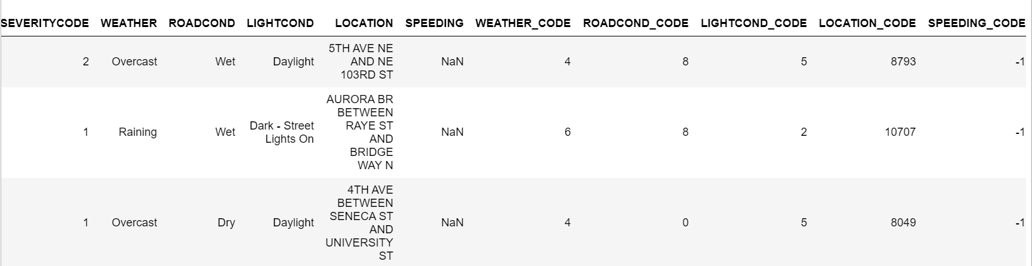
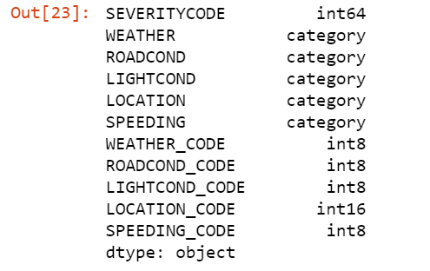
Diapositive 3
DATA UNDERSTANDING
Our target variable will be 'SEVERITYCODE' with two values (1 or 2) which correspond to the severity of the collision.
The Attributes below will be used as independent variable to train and predict the severity of an accident:
WEATHER
ROADCOND
LIGHTCOND
LOCATION
SPEED
Those attributes will be categorized and converted to code for each category.
3

Slide 4
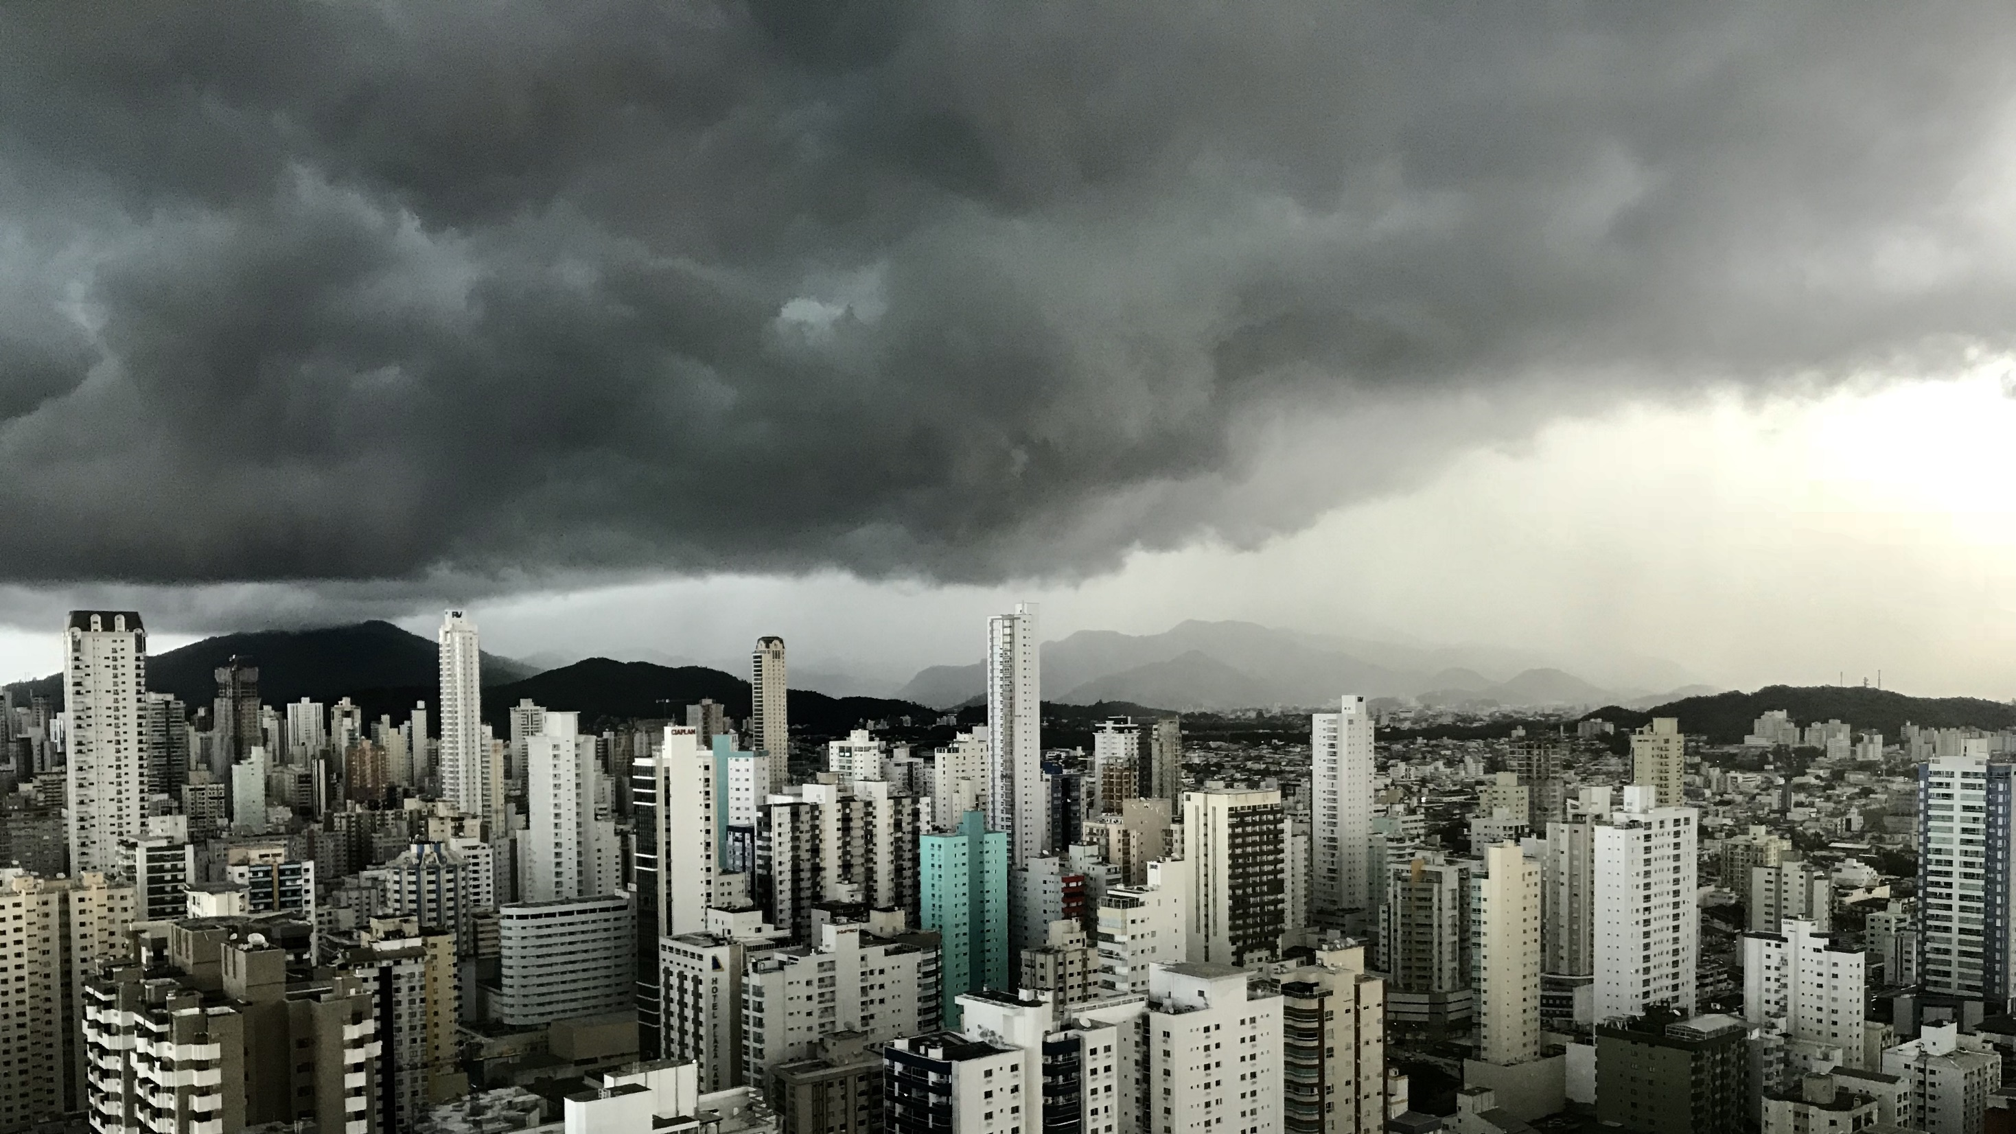
Diapositive 11
THANKS

